Slide 1

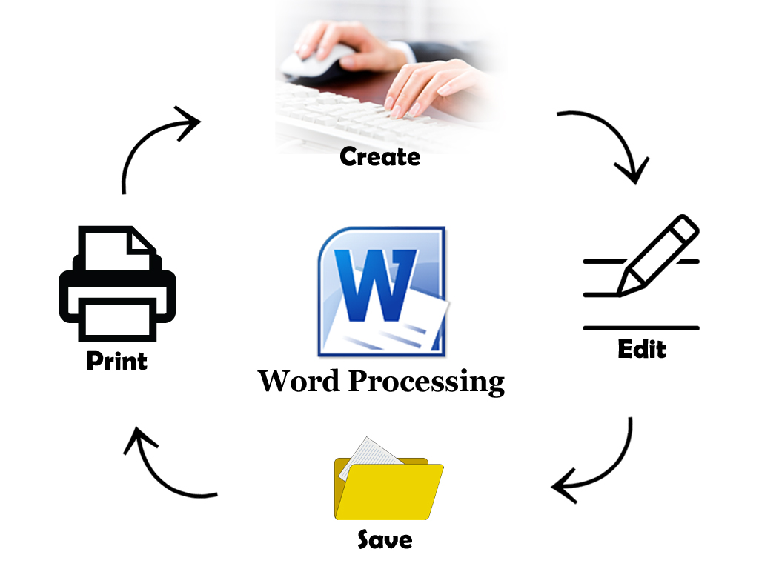


Word
Processing
Class V
lab 14

Slide 2
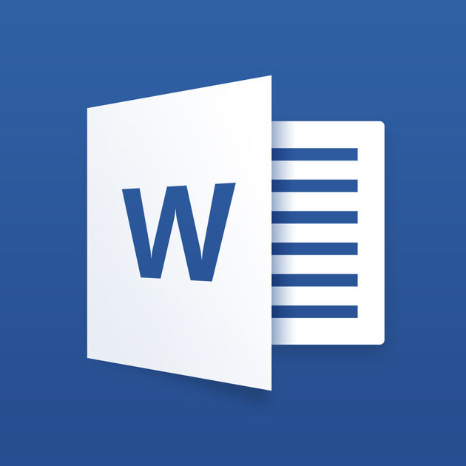
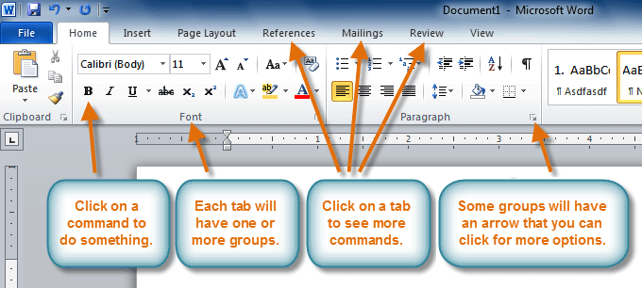
The Ribbon
contains multiple tabs, each with several groups of commands, and you can add your own tabs that contain your favorite commands

Slide 3
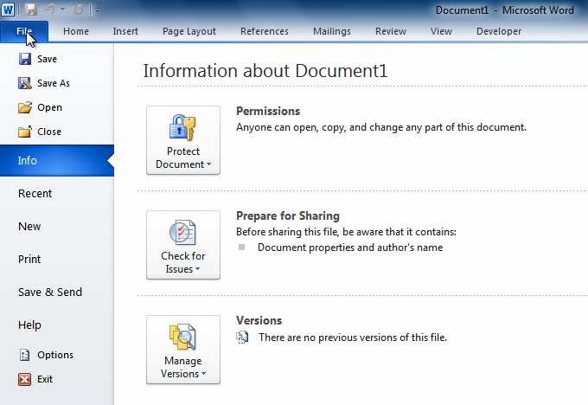
The Backstage View
Backstage View that allows you to manipulate aspects of a file

Slide 4
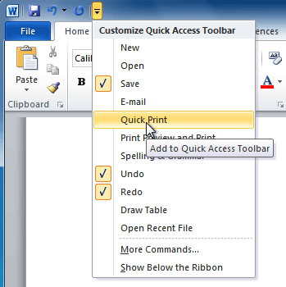
Quick Access toolbar
It contains commands that are used most often, for example Redo, Undo and Save.

Slide 5
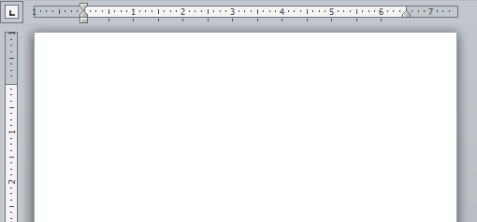
The Ruler
In word processing, a line running across the display screen. It measures the page layout in points, picas, inches, or centimeters. It is sometimes called the ruler line and is particularly useful for setting margins and tabs

Slide 6


